Slide 1
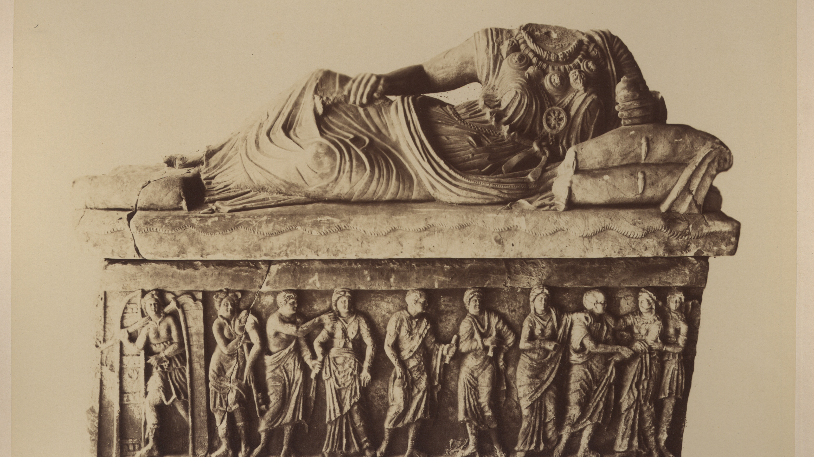
Partizione Antica
Enrica Zani
University of Bologna (former student)
PHAROS: The International Consortium of Photo Archives
Digital Art History Projects Showcase
November 8, 2023
Looking for a XIXth century art historian
Notes:
Good afternoon to everyone and thank you for the invitation [, it is a pity not being there with you for the presentation]
I am Enrica Zani and, as a former student, I will present my project that has been focused on discovering more information about a mysterious photo archive collector.

Slide 2
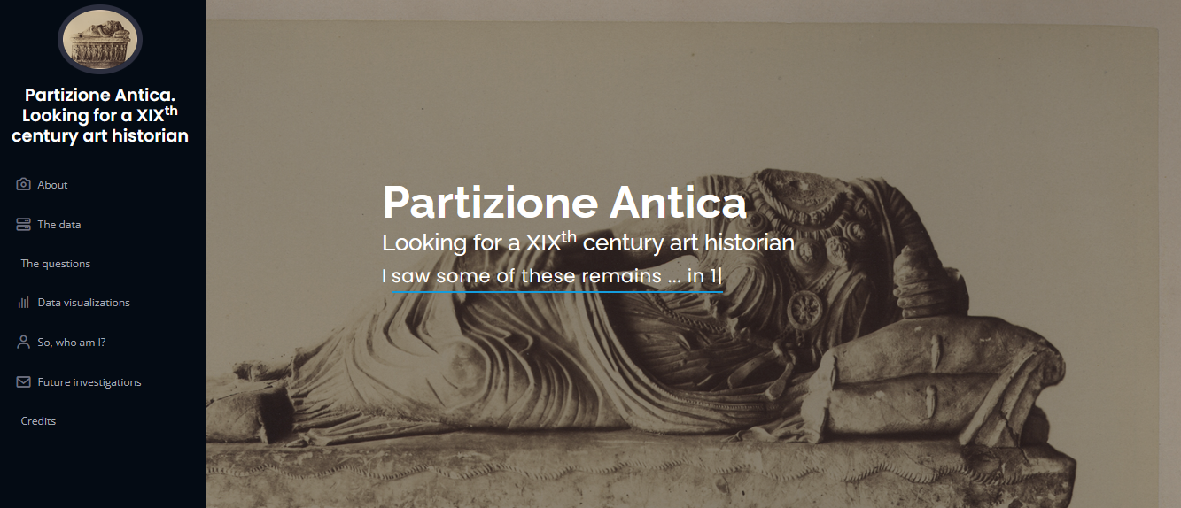
Website project
Disclaimer:
All the images are shown for illustrative and didactical purposes only.
Images: CC-BY-NC credits to Biblioteca delle Arti. Sezione di Arti visive "I. B. Supino". Alma Mater Studiorum Università di Bologna
OA and F entries: CC-BY-NC credits to Fondazione "Federico Zeri"
Website: https://enri-ca.github.io/EPDS_EZ
Github repository: https://github.com/enri-ca/EPDS_EZ
Jupiter Notebook https://github.com/enri-ca/EPDS_EZ/blob/main/EPDS_EZ.ipynb
Notes:
This is the website screenshot together with the URLs to join it, to access the GitHub repository and the Jupiter notebook where the data are stored and elaborated; and a summary of credits of images and data provided by the Zeri Foundation and the Biblioteca delle Arti.

Slide 3
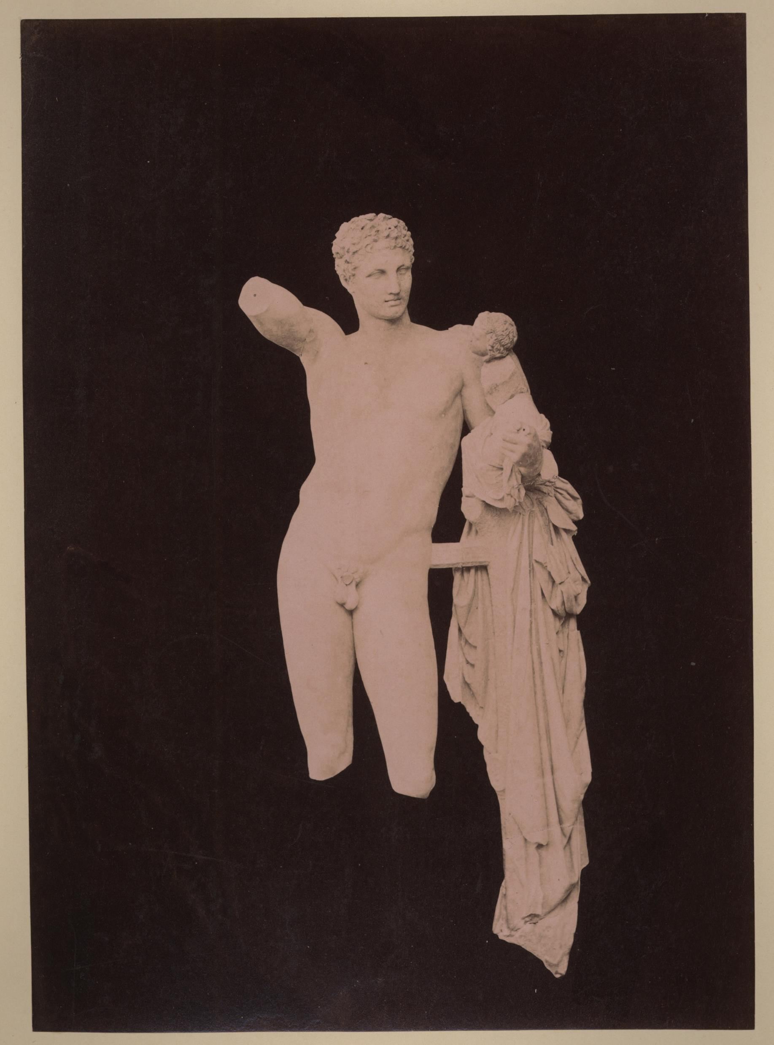
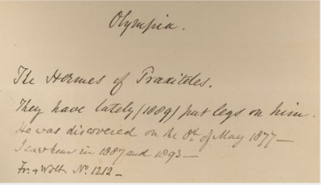
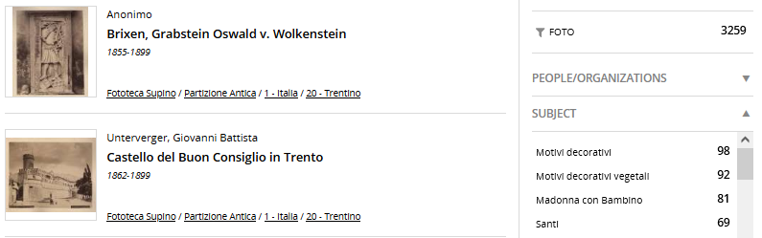
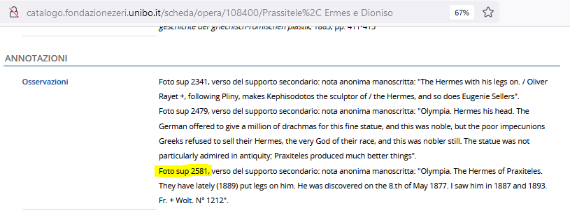
About
Anonimo <1855-1920>. 1877. [Ermes Di Praxiteles : Museo Archeologico : Olimpia. sup 2581 - PA Grecia II 040
The Partizione Antica is a series counting about 3000 photographs of the Fondo Supino art photo archive belonging to the Biblioteca delle Arti (Università di Bologna)
The photographs often carry on the verso side, handwritten annotations in English from the same hand
The series has been quite well studied and treated in the past
In 2019 the photos have been described according to scheda F and OA models: the metadata and the digitalization of the photos are accessible from the Zeri Fundation catalogue
Annotations are partially transcribed in OA entries
But the original collector identity remains unknown
Notes:
So, what are we talking about?
The Partizione Antica is a series of about 3thousend photos belonging to a bigger photo archive, and their peculiarity, apart from the technique and the ancient age, are the handwritten annotations on the back side, written from the same hand, presumably the same collector we are looking for.
These photos have been already treated in the past and the last cataloguing comes from an agreement between the Dipartimento delle Arti and the Zeri Foundation for their treatment according to F (photos) and OA (works of art) models from Italian Ministry of Culture.
In that occasion, the annotations have been partially transcribed in the OA entries.
But still, the identity of the collector remains unknown.
Charles Newton, Wolfgang Helbig, George Dennis, Eugénie Sellers Strong, Phil Perkins, John Ruskin, Heinrich Schliemann, etc

Slide 4
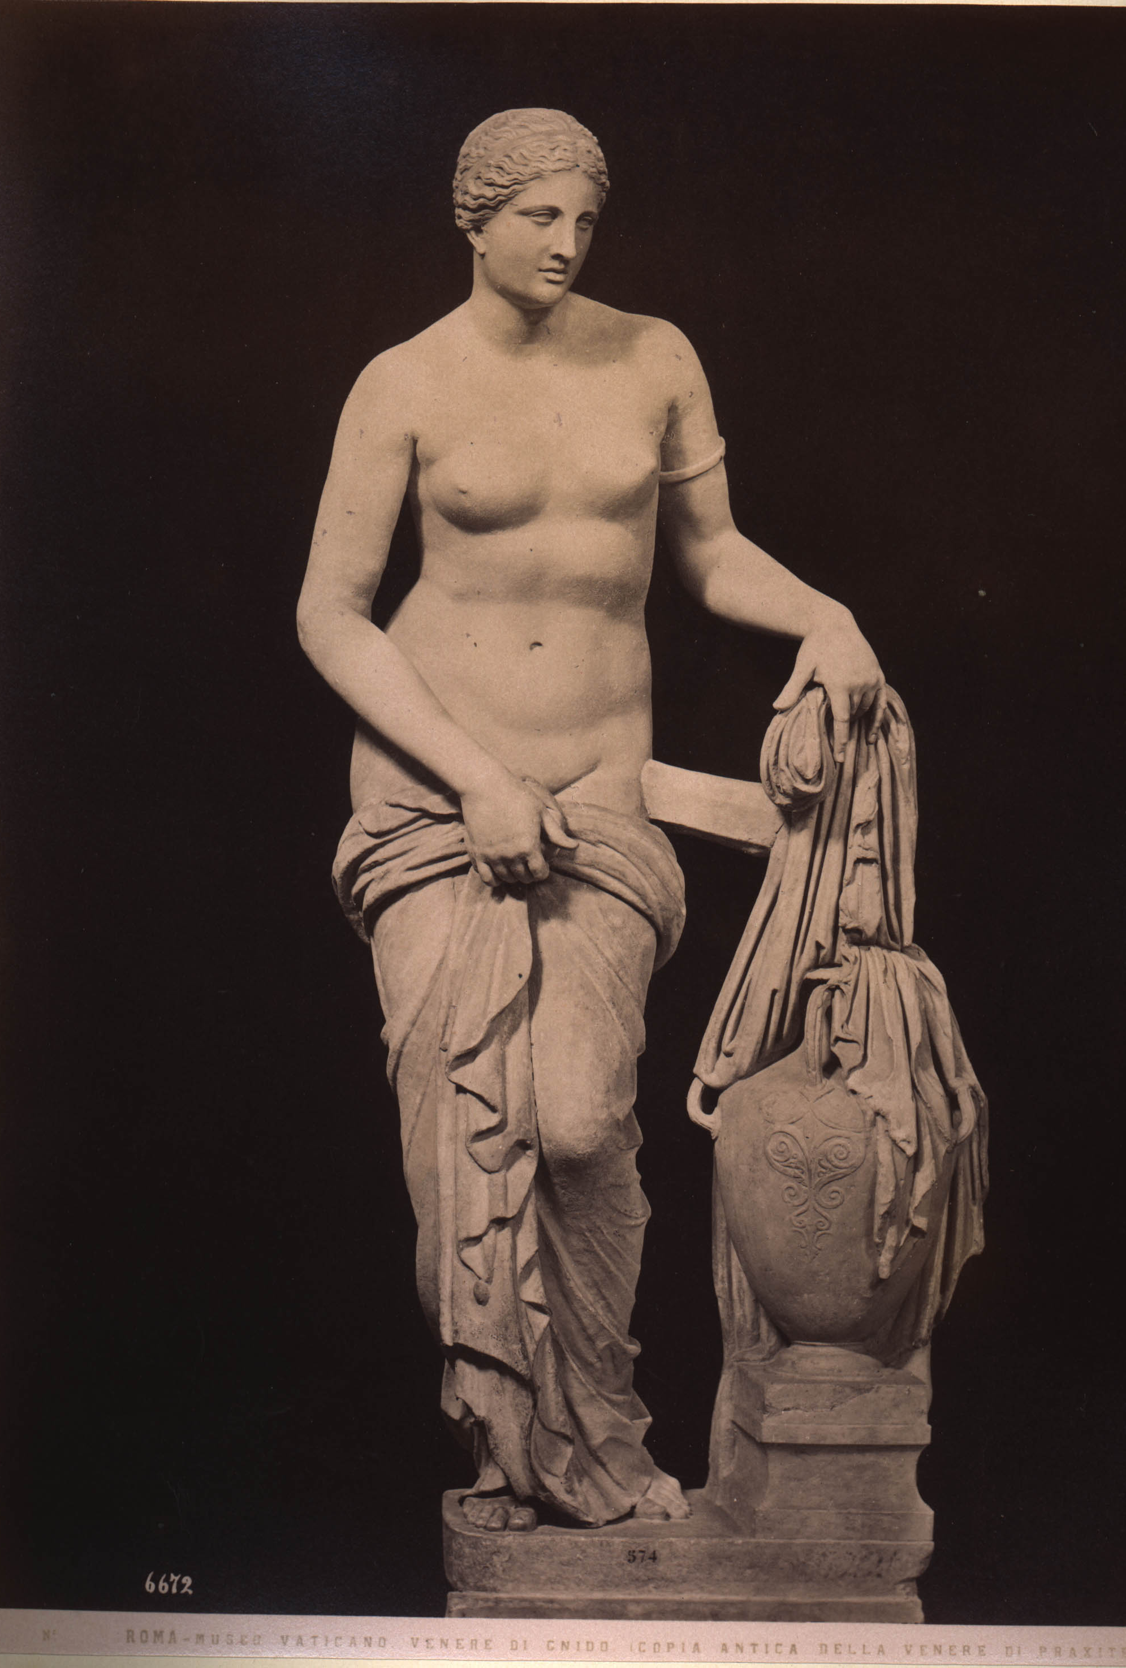
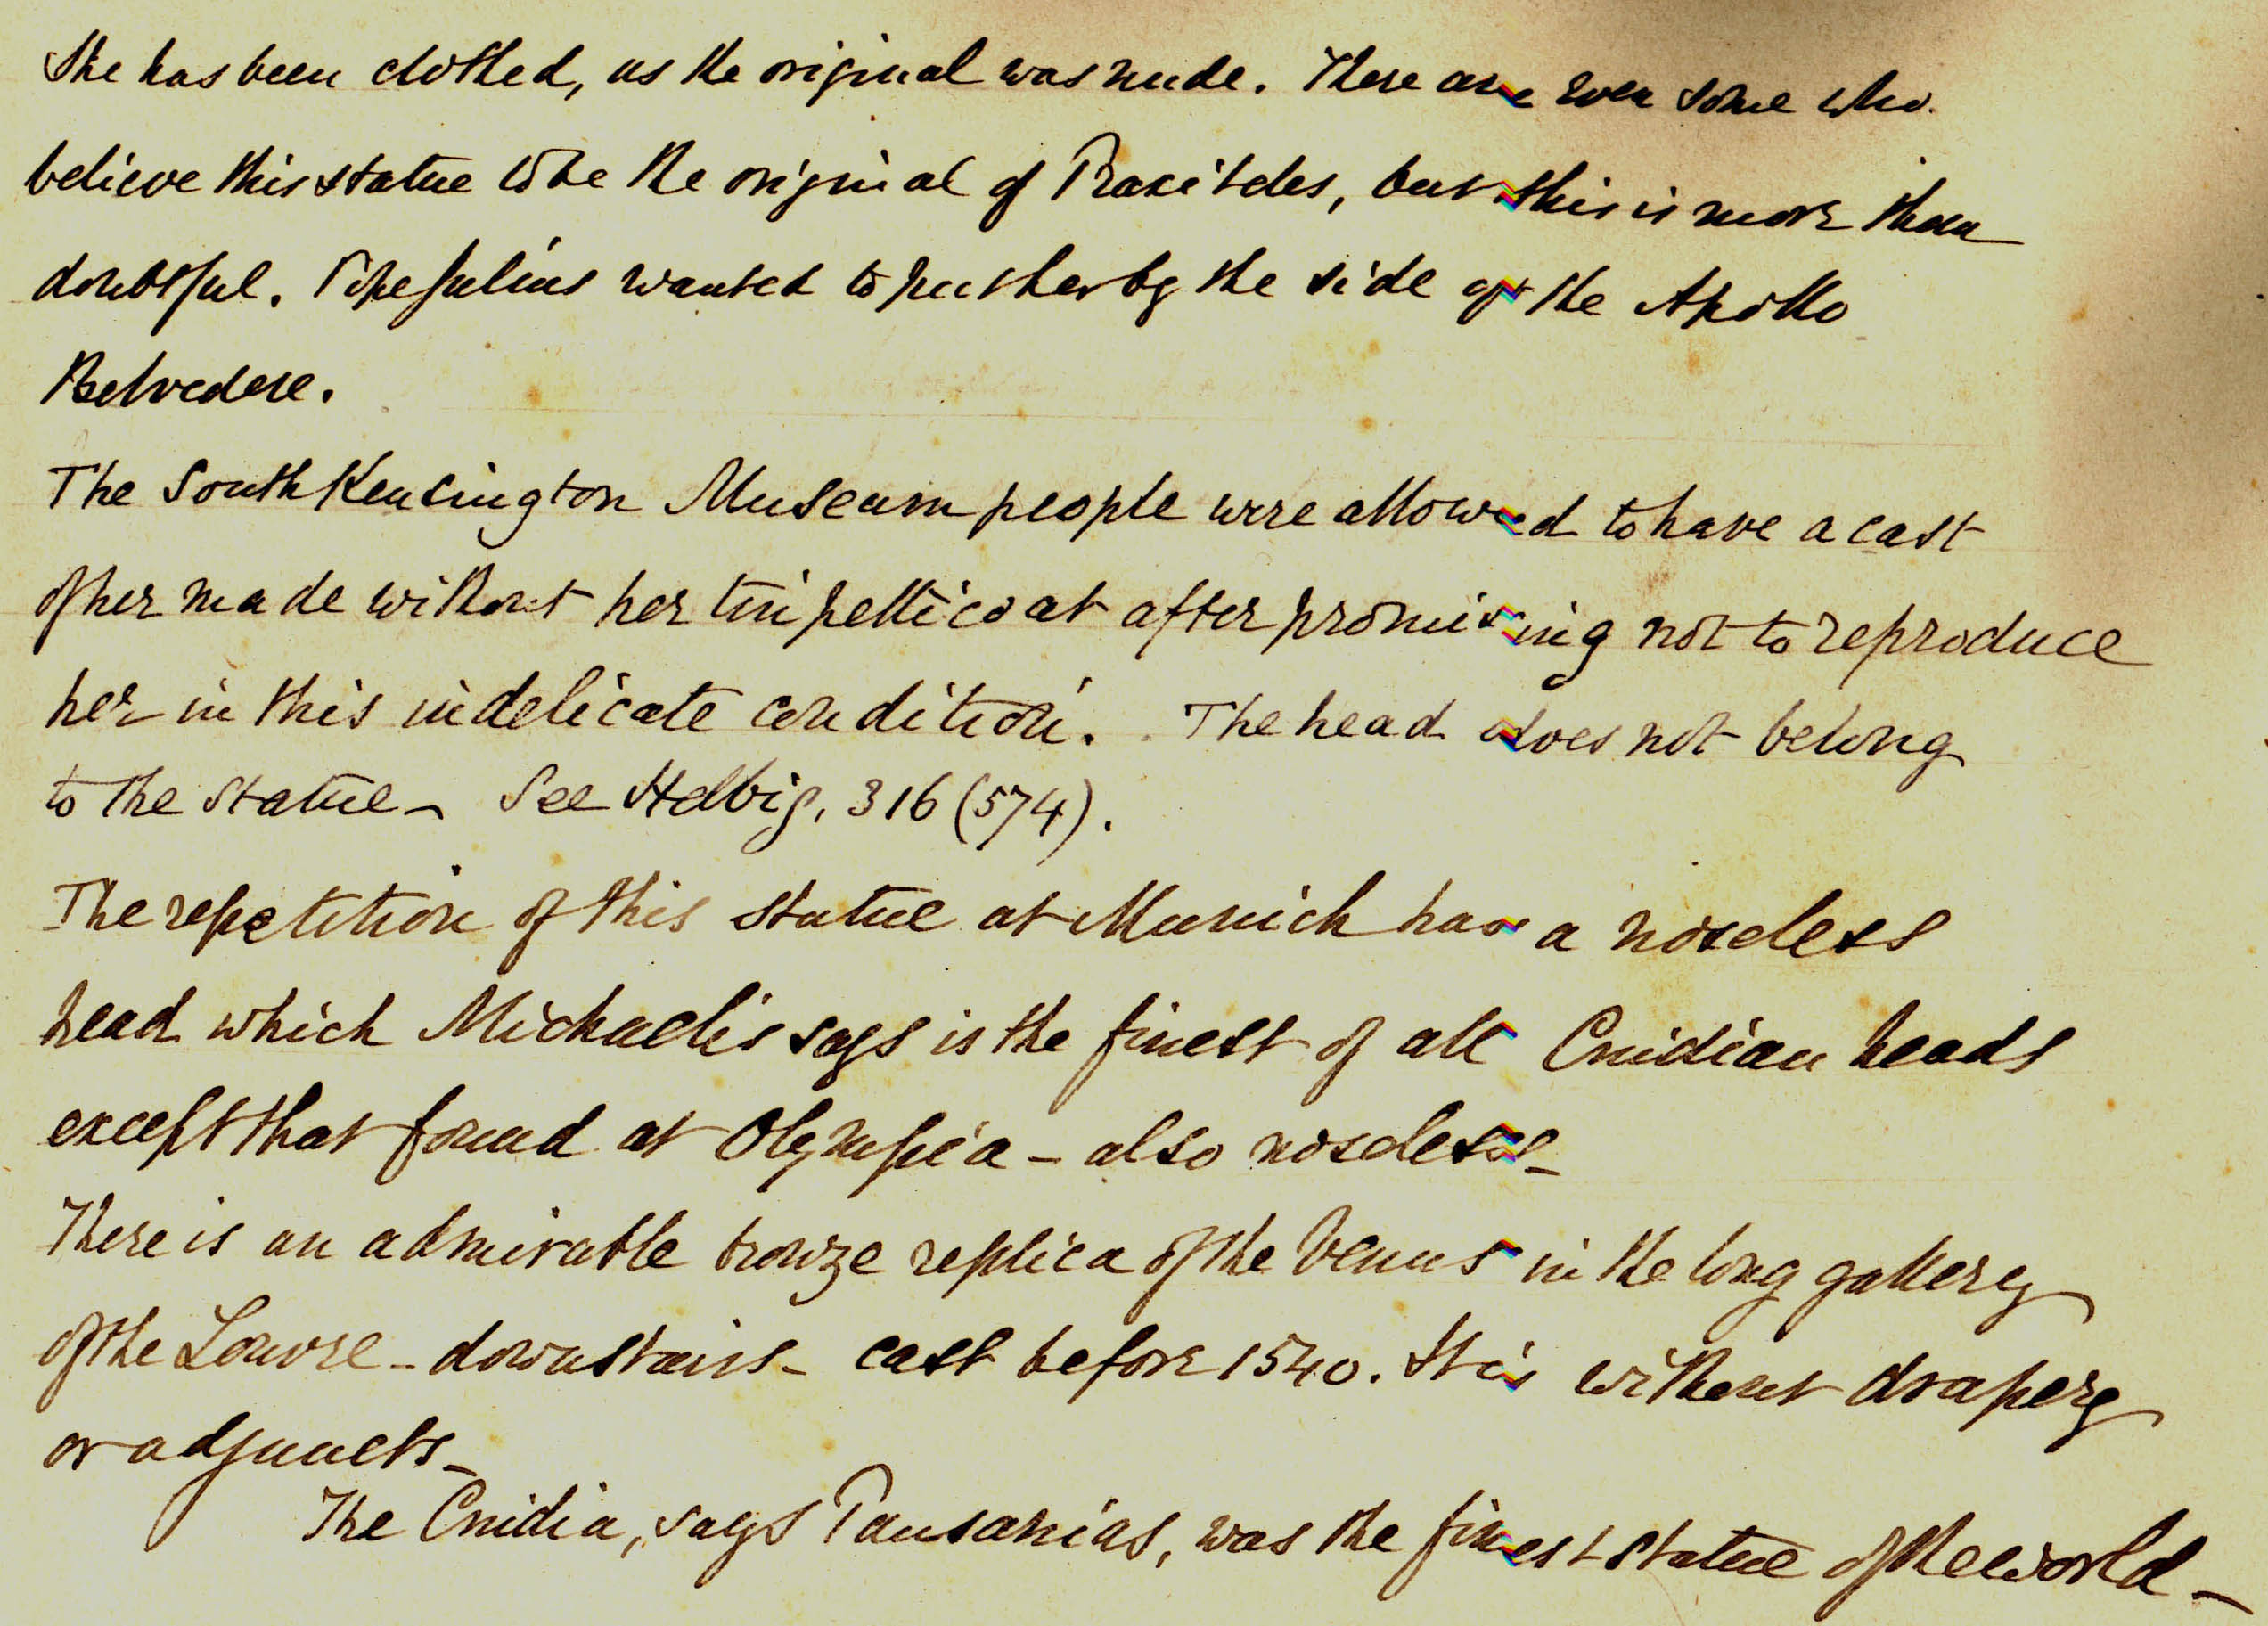
The question
Anonimo <1854-1916>. 1876. Roma : Museo Vaticano : Venere Di Cnido (Copia Antica Della Venere Di Praxitele). Alinari <Fratelli Alinari>. sup 733 - PA Roma II 063
Who (is the art historian who) created the “Partizione Antica”?
Notes:
So, my research question has been quite easy to be formulated: who is this art historian who collected the Partizione Antica?

Slide 5
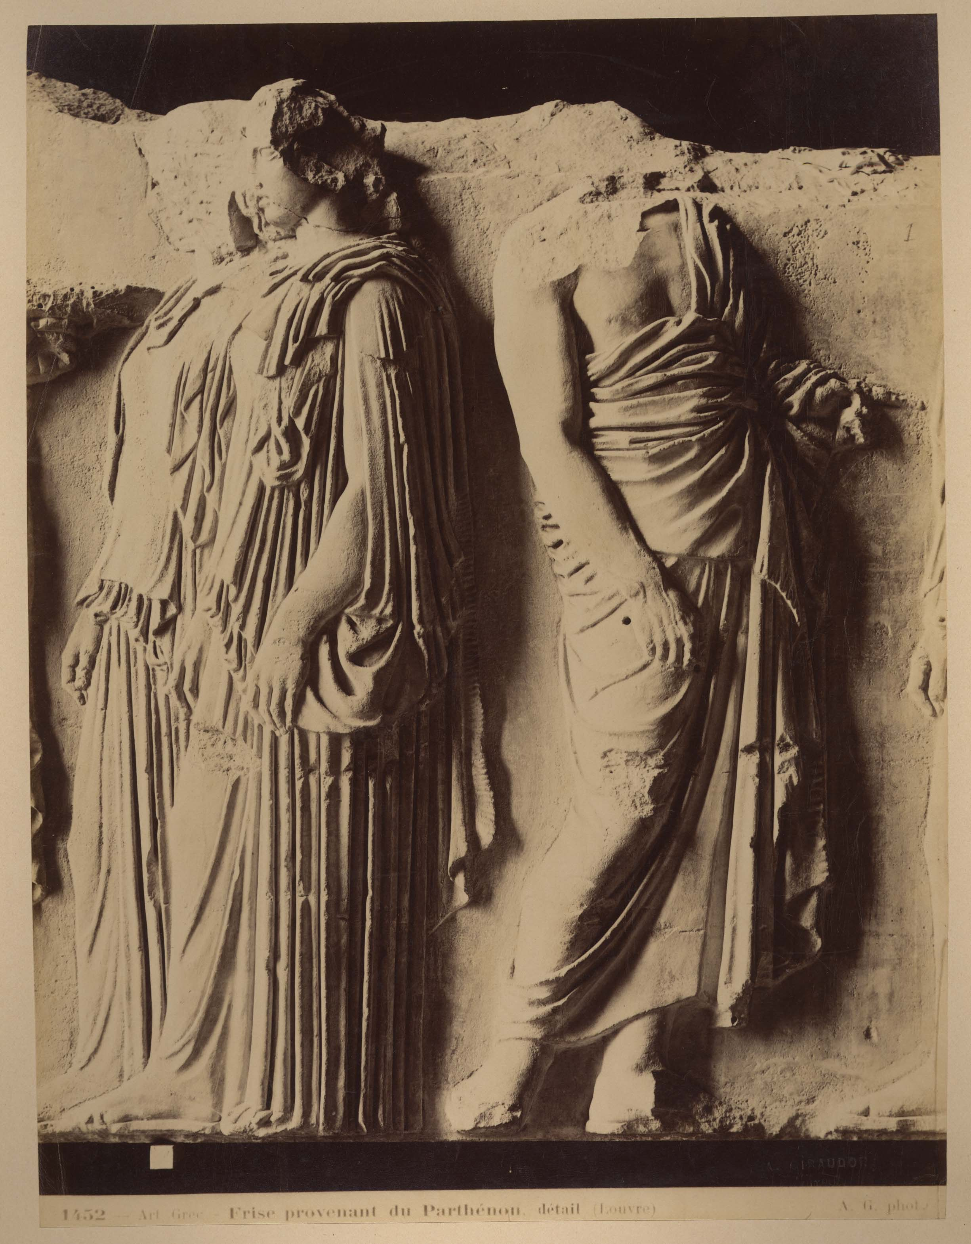
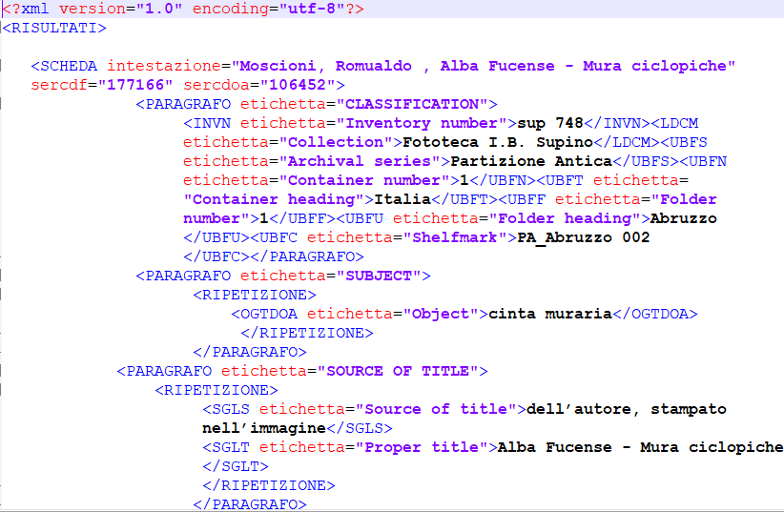
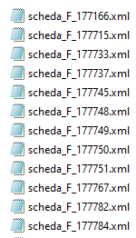
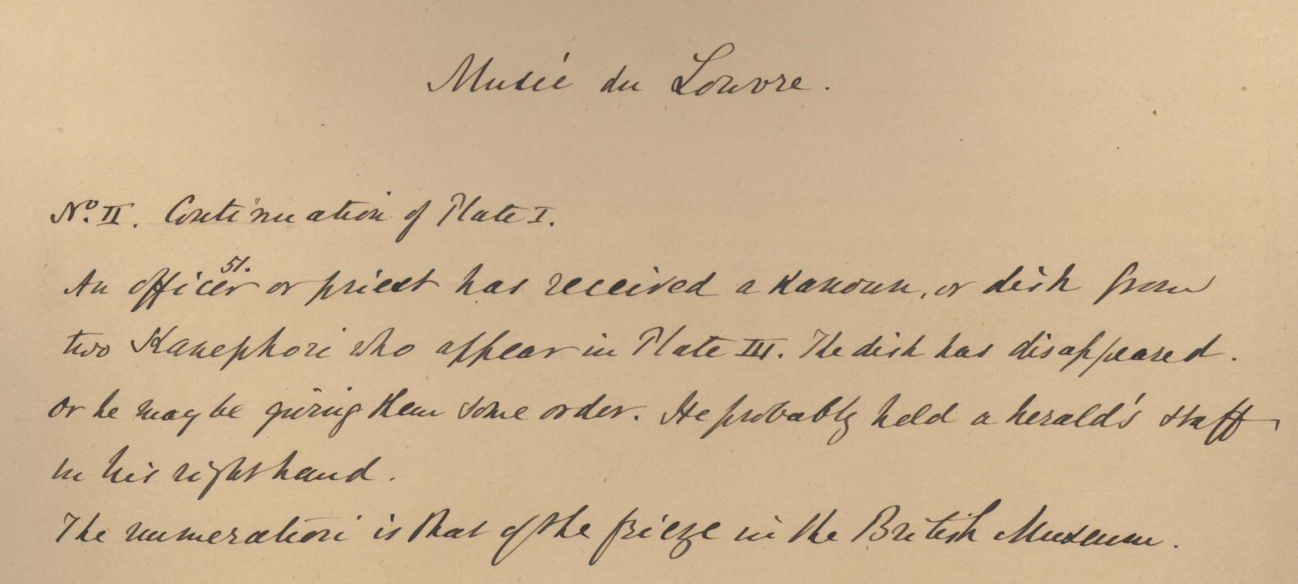
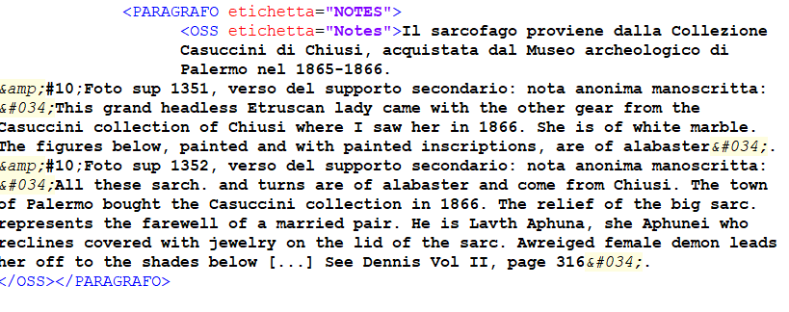
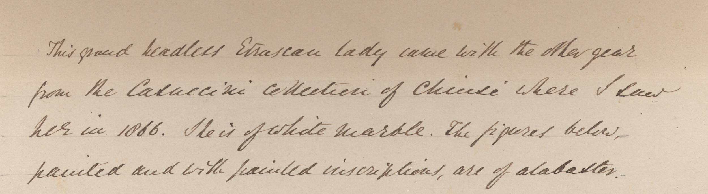
The Data
Giraudon, Auguste. 1877. Art Grec : Frise Provenant Du Parthénon, Détail (Louvre). Giraudon, Auguste. sup 2225 – PA Francia 077
Structured metadata:
- 3.232 F entries
- 2.634 OA entries
XML format from Zeri catalogue
Unstructured data (free texts):
- 1.838 free texts
transcribed annotations in OSS field of OA entries
Notes:
To do that, I used two kinds of data: from one side, structured data in xml format from a Zeri catalogue extraction, “traditional metadata” I mean, not linked open data or rdf data. I used more than 3thousands photo entries and more than 2thousands works of art entries, that means we have more than one photo depicting the same work of art.
On the other hand, the unstructured texts of the annotations, not in images, but in their transcription in the OSS fields of OA entries.

Slide 6
Data preparation
STEPS
creation of unique xml files for all the F and OA entries extracted
extraction of relevant information for the project from nested xml structure
ISSUES/DESIDERATA:
Data extraction to be required (closed db) VS dynamic queries
More data format output
Focus on photographs as archival objects (instead of works of art)
es. need to rebuild connections between annotations and actual photo entry
extraction of unstructured annotations from OA data
creation of a new database merging data from the two previous steps
Notes:
In the next two slides I would like to outline the “problems” I faced or the “desiderata” I wished in data preparation and elaboration steps.
For the preparation, the possibility to have access to dynamic queries, instead of asking for static extractions, could have been an advantage to sometimes check hypothesis by comparing other records, or unexpected doubt, or minor research questions
Also, the different point of view of the job, more focused to photos as archival object, or even as support of other archival object that were the annotations, instead on works of art, lead to a challenging but time consuming reconstruction of the link between annotations texts and related photo records.

Slide 7
Data preparation
ISSUES DESIDERATA
Data extraction to be required (closed db)
Xml single files for records
Dynamic queries
Other formats
Focus on depicted works of art
Annotations in OA entries
Transcriptions useful to OA needs
Focus also on photos as archival objects
Notes:
photograph’s item level metadata, is instead reported to the work-manifestation-item level of the represented work of art in the OA entry.

Slide 8
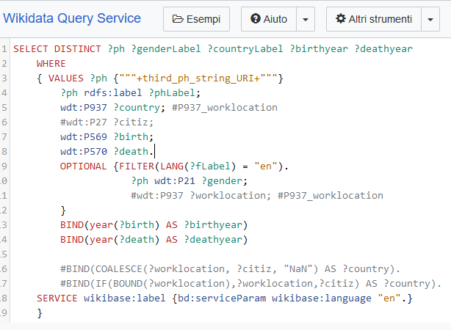
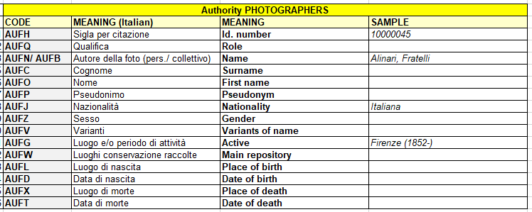

Data elaboration
STEP
Photographer: enrichment of workplace, activity timespan, VIAF number via Wikidata SPARQL queries
ISSUES/DESIDERATA:
Time saver having reference to AF identifiers (es. VIAF) in addition to just local language strings
Notes:
For the elaboration, I tried to obtain more information about photographers via SPARQL Wikidata queries and having had from the source data not just name string in local language (in the specific case, Italian) but also an international identifier, like for example VIAF, could have helped in improving matching. That is something that LOD has enormously improved.

Slide 9
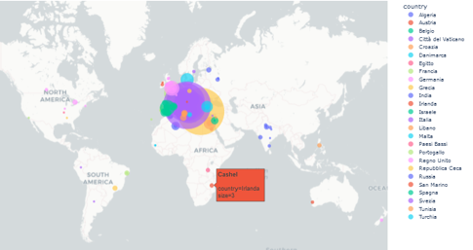
Data elaboration
STEP
Places: enhancing geolocation via geopy Python client
ISSUES/DESIDERATA:
Add geodata or Geonames ID - instead of just name strings - to source data to avoid multilingual misunderstanding and disambiguation of homonymous places
Notes:
Similar consideration for geolocating places, for which I have used Geopy Phyton Client: having geodata, or at least Geonames identifiers directly in the source data, could have helped in avoiding multilingual misunderstanding and manual disambiguation of homonymous places.

Slide 10
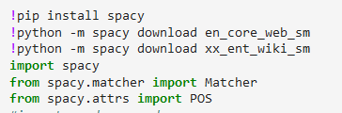
Data elaboration
ISSUES/DESIDERATA:
Annotations sample, sometimes incompleted ([…]), transcribed with a work of art focus
Best HTR to complete the corpus
Minor misspelling
Multilingual corpus
STEP
unstructured annotations: seeking for further elements running NLP and NER Python libraries

Slide 11
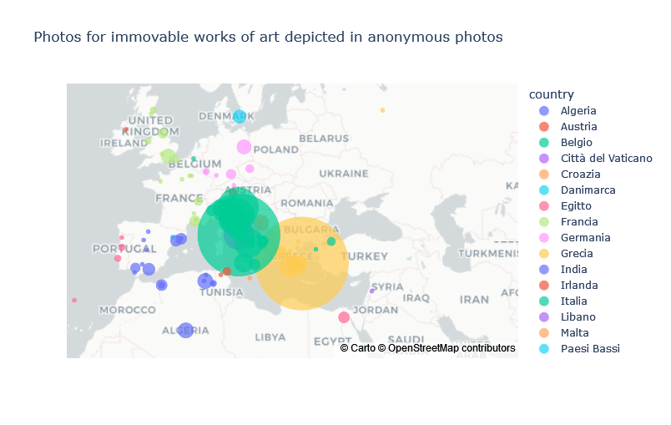
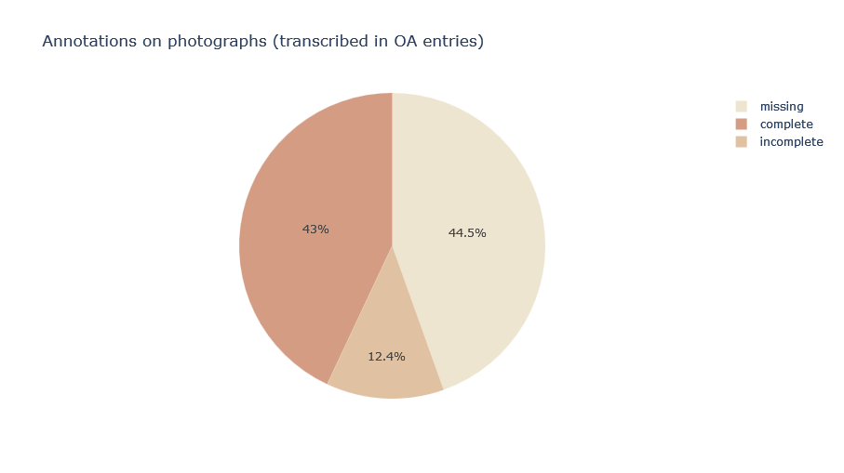

Results from structured data
already known
… and new insights
Interest for funerary sculpture and sarcophagus.
Interest in Mediterranean area
Little extra-European photos’ set (18 Indian subject)
Transcribed annotations
for more than 50% of
photographs
(1.838/3.232)
47,5% photos from relevant art history photographers (Alinari 20%, Moscioni, Brogi, Sommer 5% each, Laurent, Incorpora, Giraudon 2,5% each)
49% of anonymous photos
3,5% of photos from a big variety of other not anonymous photographers (100/111 names with less than 20 photos each)
Notes:
Anyway, what results I have obtained from structured data? In the black side the confirmation of information already known by literary review while new insights are in the white side.
For example, I can obtain confirmation about interest in Mediterranean area but also an unexpected extra European photo set about Indian subjects.
In terms of photographers present in the fund, I obviously found relevant art history photographers but also a big part of anonymous photos that can be more explored.
Data also uncover a big interest in for funerary sculpture and sarcophagus.
And finally, I could obtain the exact number of transcriptions.

Slide 12
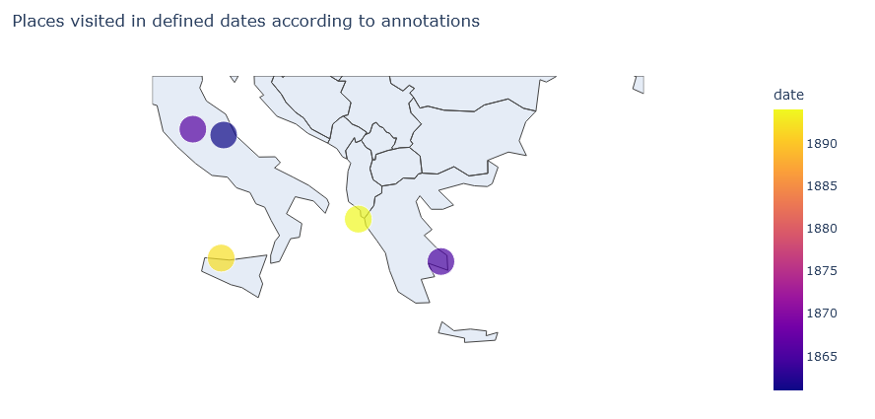



Results from unstructured texts
matcher.add("PA_creator", [[{"LEMMA": "I"}, {POS: 'VERB'}]])
= 22 occurrences
6 place-time references to personal experiences
6 ownership declarations (5/6 about medals)
10 opinions
I told the Countess Marcello (nee Grimani) that I respected her immensely on account of this statue of Agrippa. This was in Corfù in March 1894.
(sup 1811)
I have a medal of him with the inscription: / "Antonius de Royzellis monarcha sapientie"
(sup 659)
Notes:
For unstructured texts, I used some NLP and NER libraries and modules for Python such as Spacy, and in particular I looked for personal statements: after minor refinements, we could obtain 22 occurrences, 6 of them about personal experiences with place and time, like in this case, that help us to draw a map of the collector movements at that time; 6 are about ownership, in particular of medals, and 10 about opinions.

Slide 13
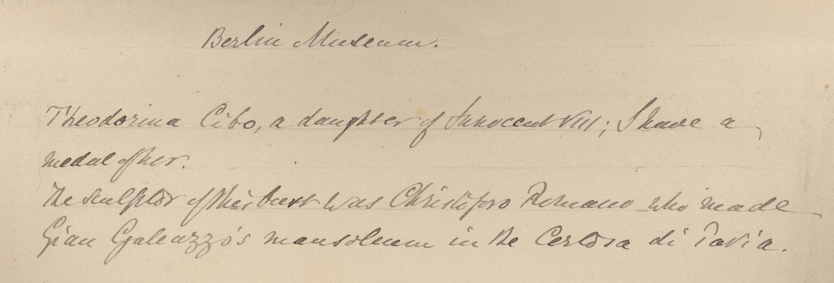
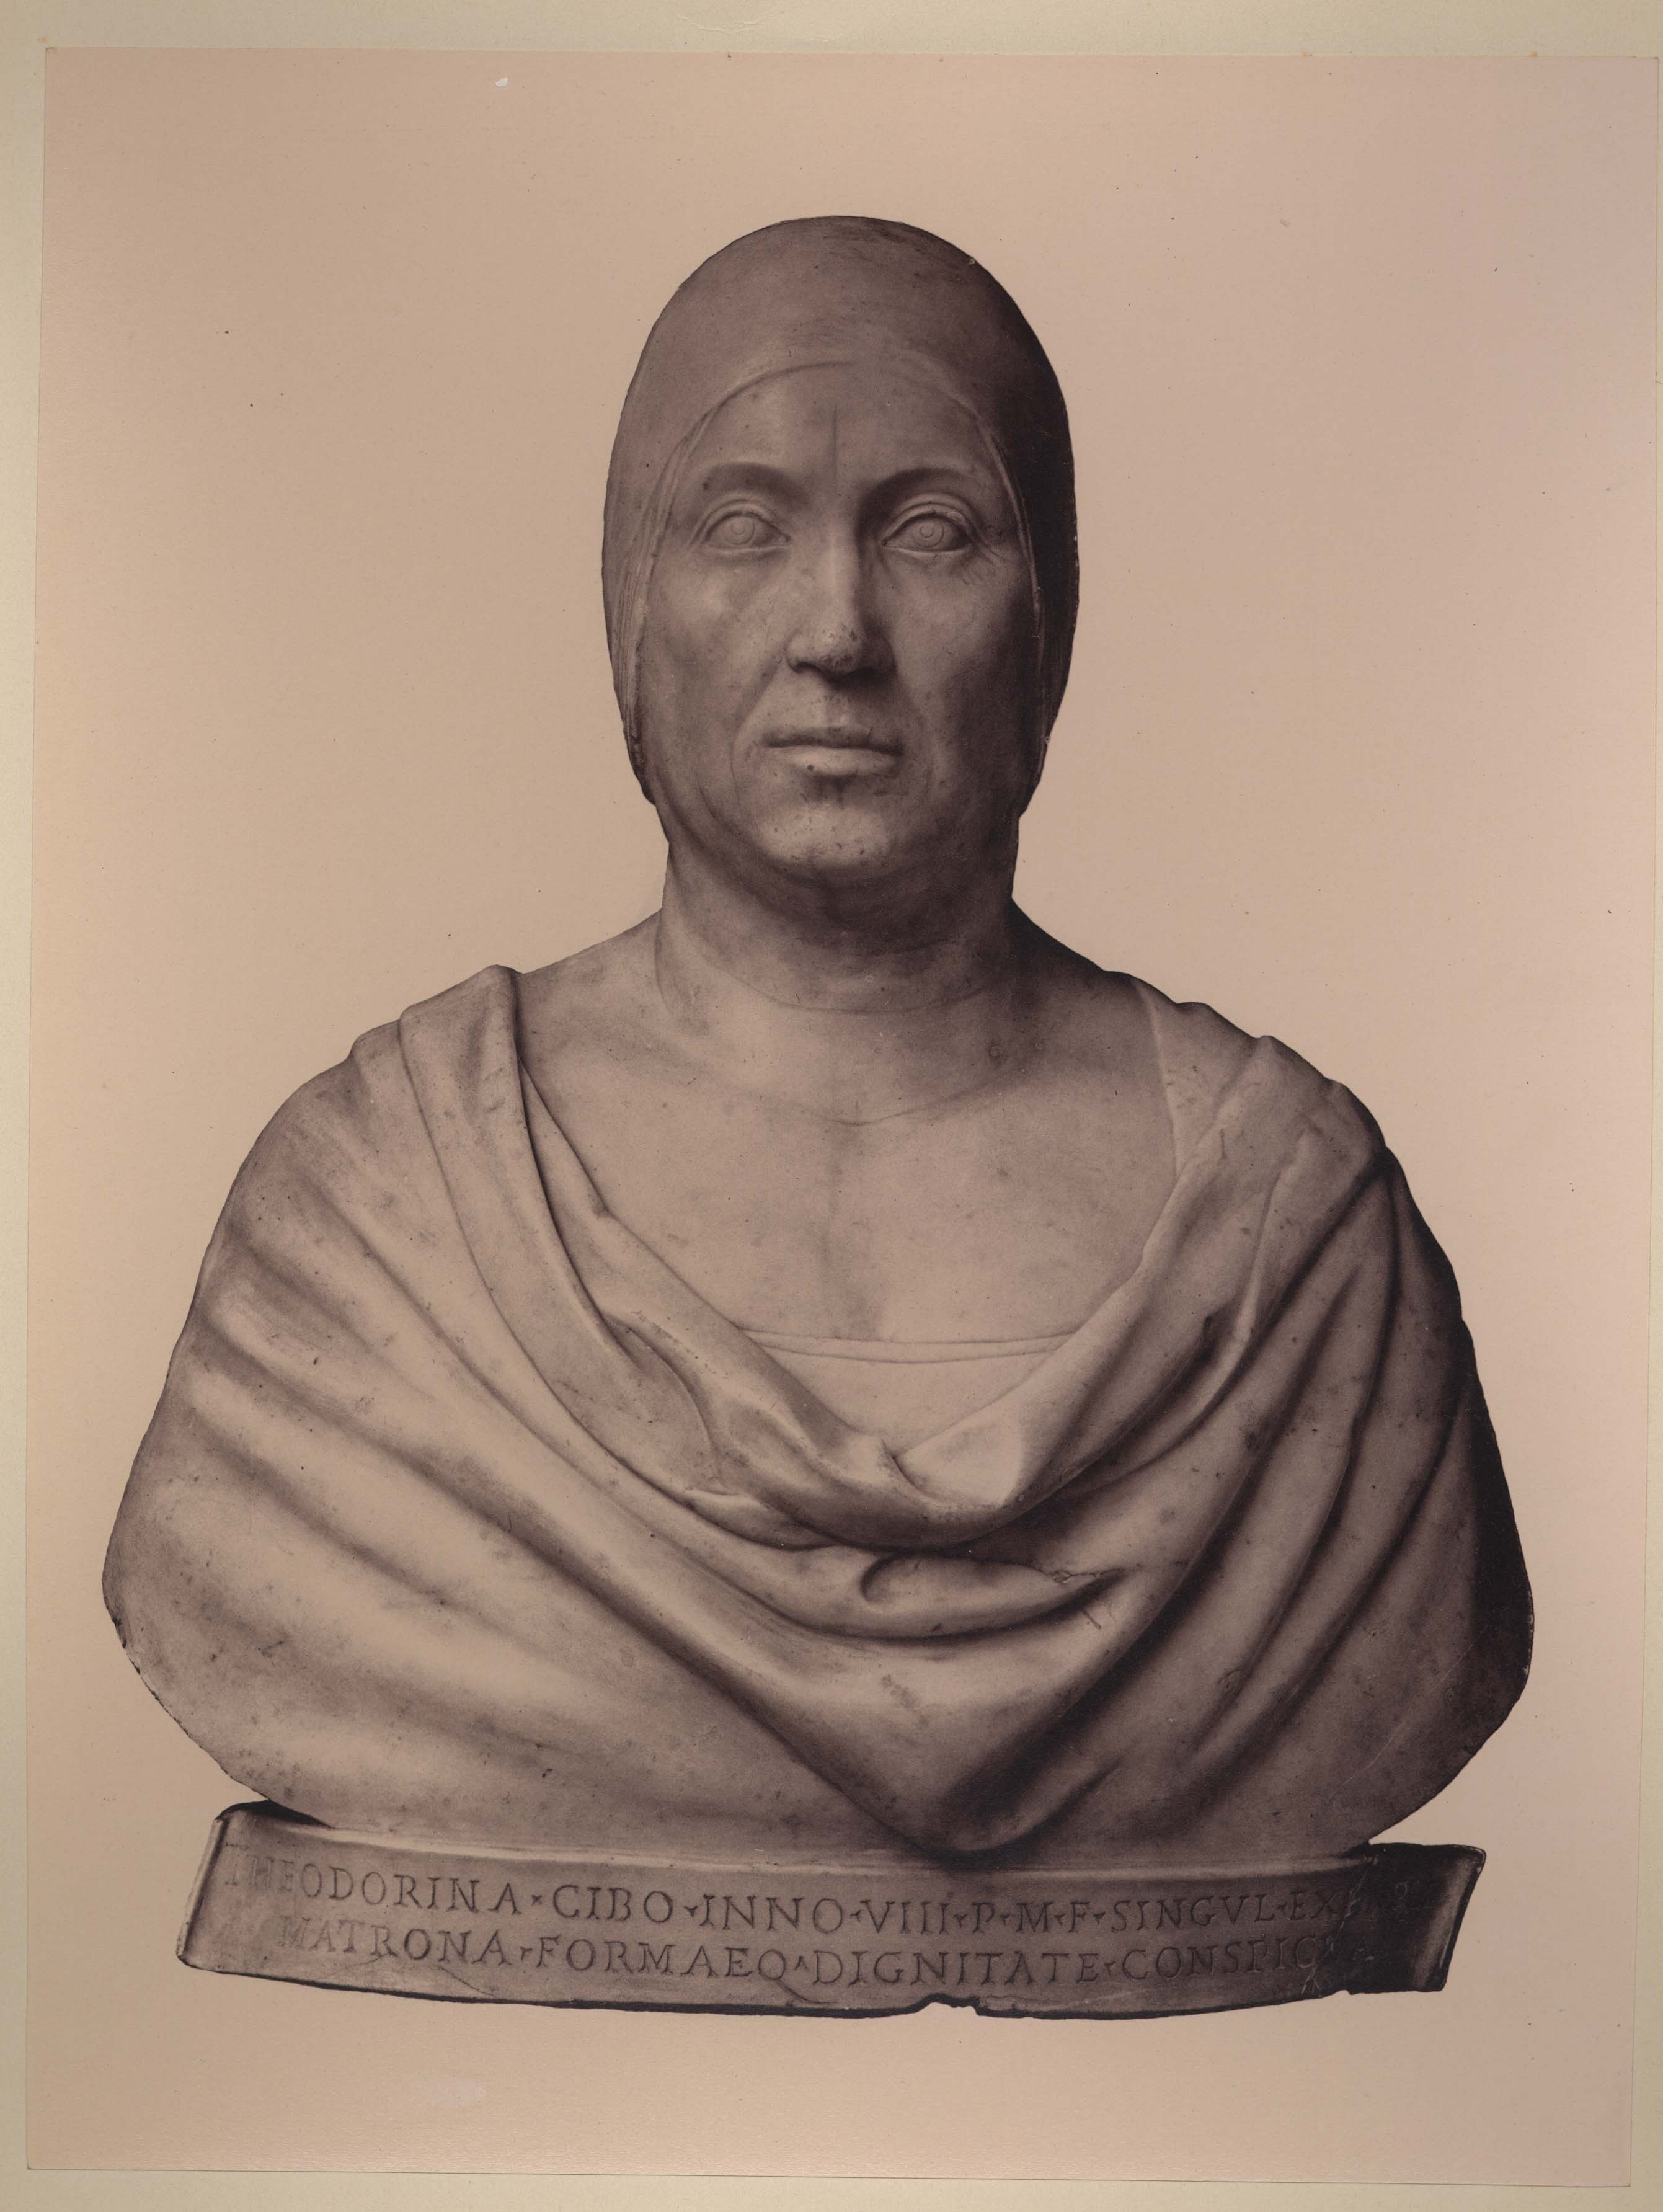
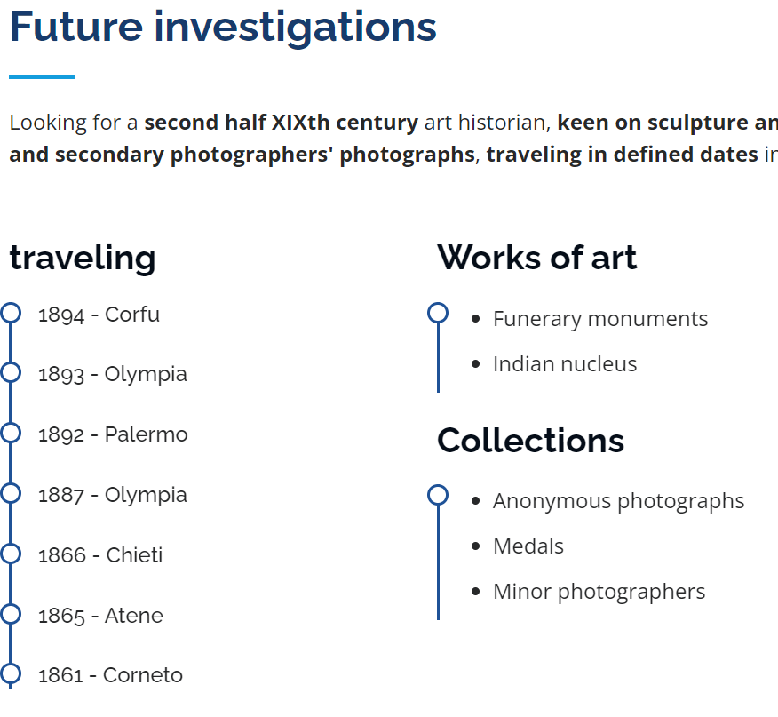
Further investigations
Anonimo <1855-1920>. 1855. [Busto Di Teodorina Cibo Di Gian Cristoforo Romano : Staatliche Museen, Skulpturensammlung : Berlino. sup 2800 – PA Germania 006
What it would be useful to have

Slide 14
Further investigations
Anonimo <1855-1920>. 1855. [Busto Di Teodorina Cibo Di Gian Cristoforo Romano : Staatliche Museen, Skulpturensammlung : Berlino. sup 2800 – PA Germania 006
What it would be useful to have
Notes:
So, what else for further investigations? What it would be useful to have?

Slide 15
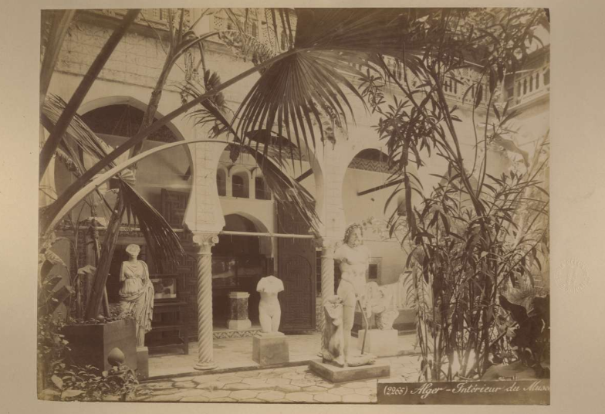
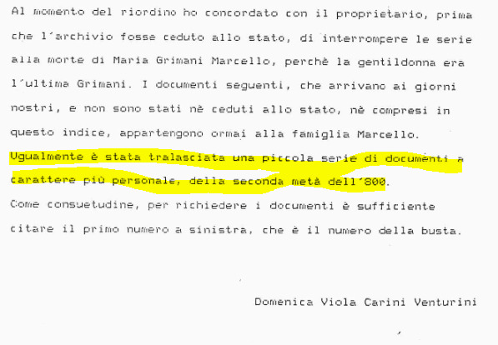
Wish list
Etienne Neurdein, Alger : 271 : Intérieur Du Musée : Vue Panoramiques (Neurdein, Etienne, 1845). sup 3149 – PA Algeria 012
Photos, photographers and historical archival focus
Annotations related to F entries
Possibility to query other photo archives by negative number (or visual search)
References and links to named entities in annotations, es.: Countess Marcello (nee Grimani) = 'Maria Grimani Giustinian’
http://dati.san.beniculturali.it/SAN/complarc_GGASI_san.cat.complArch.52480
Notes:
First of all, what I have already outlined in the presentation, a stronger photos, photographers and archival or historical focus next to the privileged “works of art” point of view: for example by providing annotations directly in the related photo entries.
But also, for example, the possibility to query other photo archives by negative number (or even visual search): this is an anonymous photo that, maybe, could have more data in other photo archive descriptions.
And slight references to named entities in annotations: for examples for the “Countess Marcello” that we have just seen in the previous slide, I could find the Family Archive, kept at Archivio di Stato di Venezia. The available online finding aid, said that ufortunately personal documents of second half of nineteenth century have not been preserved, so…
such as cidoc crm:P67_refers_to

Slide 16
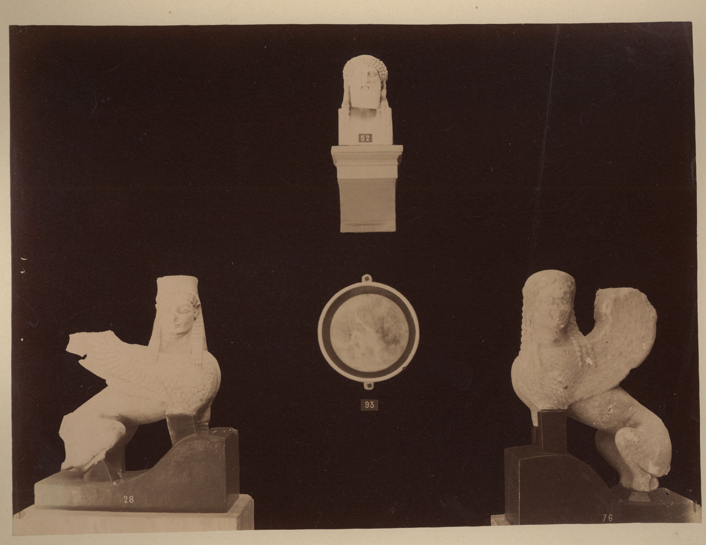
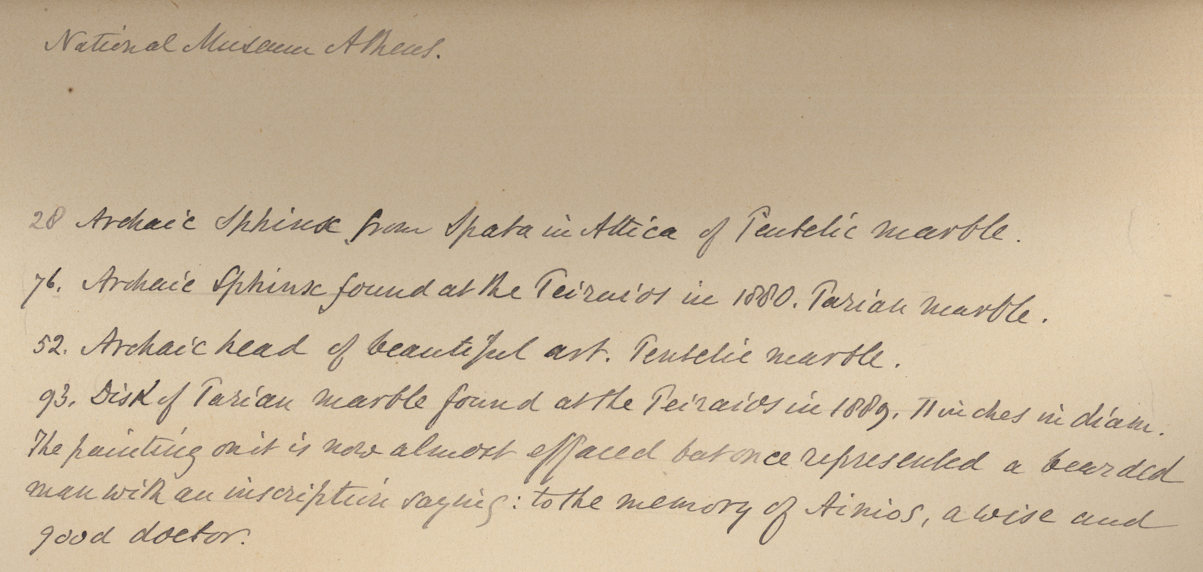
Thank you
Anonimo <1855-1920>. 1890. [Sfinge Arcaica in Marmo Pentelico Proveniente Da Spata, Sfinge Arcaica in Marmo Pario Trovata Nel Pireo, Testa Arcaica in Marmo Pentelico e Disco Di Marmo Pario Trovato Sul Pireo : Museo Archeologico Nazionale : Atene. sup 2832 – PA Grecia III 051
Keep on looking for…
enrica.zani@studio.unibo.it
Notes:
I am keeping on looking for …. 😉
Thank you for your attention, and to the people helping me in doing this project.

